Slide 1
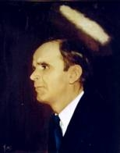

103
DON’T FORGET PRAYER
Don’t forget the family prayer,
Jesus wants to meet you there;
He will take your every care,
Oh, don’t forget the family prayer.

